Slide 1
Security Controls

Slide 2
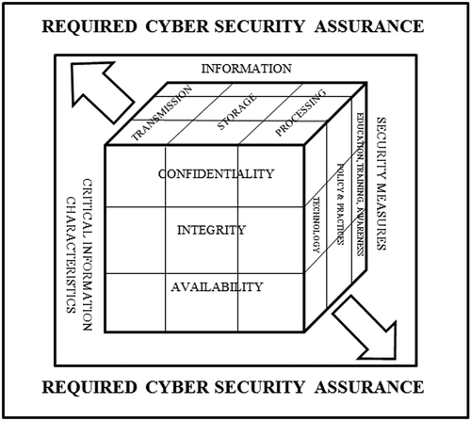
Information Quality
This is the McCumber cube model.
It encapsulates Assurance –
Characteristics of data
States of data
Security controls

Slide 4
The only secure computer…
“The only truly secure system is one that is powered off, cast in a block of concrete and sealed in a lead-lined room with armed guards - and even then I have my doubts.”
"Computer Recreations: Of Worms, Viruses and Core War" by A. K. Dewdney in Scientific American, March 1989, pp 110.
Information Security vs. Information Assurance

Slide 5




Security COntrols
Powered Off
Cast in Concrete
Sealed in a Lead-Lined Room
Armed Guards
What are we trying to accomplish?

Slide 6
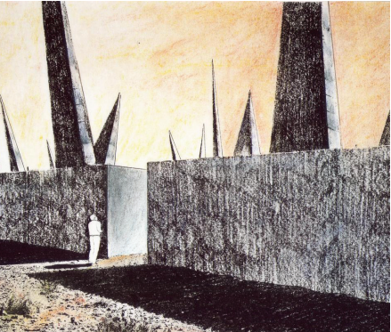
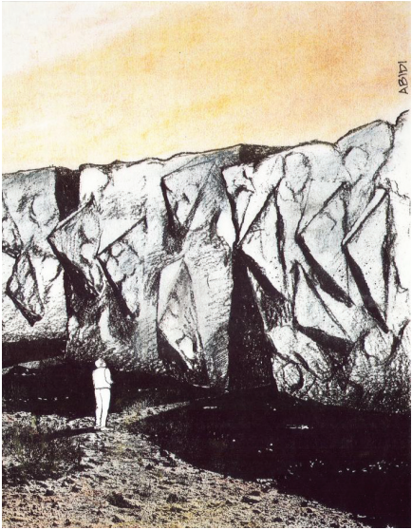
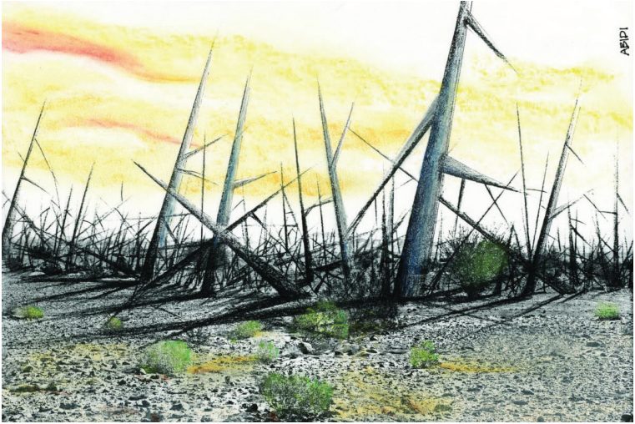
This place is a message… and part of a system of messages… pay attention to it! Sending this message was important to us. We considered ourselves to be a powerful culture.
This place is not a place of honor…no highly esteemed deed is commemorated here… nothing valued is here.
What is here is dangerous and repulsive to us. This message is a warning about danger.
The danger is in a particular location… it increases toward a center… the center of danger is here… of a particular size and shape, and below us.
The danger is still present, in your time, as it was in ours.
The danger is to the body, and it can kill.
The form of the danger is an emanation of energy.
The danger is unleashed only if you substantially disturb this place physically. This place is best shunned and left uninhabited.

Slide 7
Security Controls - Types
Technical (aka. Logical/Operational) controls are implemented using software, hardware, or firmware that restricts logical access on an IT system. Examples include firewalls, routers, encryption, etc.
Physical controls place physical barriers before data, like fences, security guards, moats, etc.
Administrative (aka. Directive/Managment) controls are implemented by creating and following organizational policy, procedure, or regulation. User training and awareness also fall into this category, as does incident response processes, management oversight
Regulatory (aka. Legal/Compliance) controls are administrative controls that originate outside the organization – they do not make the rules but are obligated to follow them.

Slide 8
Security Controls - Modes
PREVENTIVE
Preventive controls prevent actions from occurring. It applies restrictions to what a potential user, either authorized or unauthorized, can do. An example of an administrative preventive control is a preemployment drug screening. It is designed to prevent an organization from hiring an employee who is using illegal drugs.
DETECTIVE
Detective controls are controls that send alerts during or after a successful attack. Examples of detective controls are intrusion detection systems that send alerts after a successful attack, closed-circuit television cameras that alert guards to an intruder, and a building alarm system that is triggered by an intruder.
CORRECTIVE
Corrective controls work by “correcting” a damaged system or process. The corrective access control typically works hand in hand with detective access controls. Antivirus software has both components. First, the antivirus software runs a scan and uses its definition file to detect whether there is any software that matches its virus list. If it detects a virus, the corrective controls take over and either places the suspicious software in quarantine or deletes it from the system.

Slide 9
Security Controls - Modes
RECOVERY
After a security incident has occurred, recovery controls may need to be taken in order to restore the functionality of the system and organization. Recovery means that the system must be restored, which involves reinstallation from OS media or image, data restored from backups, etc.
DETERRENT
Deterrent controls deter users from performing certain actions on a system. One example is a “Beware of Dog” sign; a thief encountering two buildings, one with guard dogs and one without, is more likely to attack the building without guard dogs. Another example is large fines for drivers who speed. A deterrent control is a sanction policy that makes users understand that they will be fired if they are caught surfing illicit or illegal websites.
COMPENSATING
A compensating control is an additional security control put in place to compensate for weaknesses in other controls.

Slide 10
All sorts of access
Some are better in certain situations than others. For example, let’s say you have a security problem: Physical access to the facility. There are multiple ways to potentially solve that.
An administrative control might be writing a policy that says all employees must always display identification while in the facility.
A technical control might be putting card readers at the door, requiring swipes to unlock the door.
A physical control might be posting a security guard at the gate.

Slide 11
In that scenario, we have three types of controls and three solutions, all are likely effective in some way and finding each of them in use simultaneously would be most likely. But which is most effective at solving this problem. The CISSP exam uses these questions for exactly this reason…
Having a policy makes wearing a badge a rule. When a rule is broken the infraction can be punished, but it’s not going to stop people from breaking them in the first place. Making a rule and punishing infractions is a deterrent.
Having the card swipers means the doors aren’t unlocked unless someone with a badge is present. It prevents access from unauthorized individuals. It is, in essence, single-factor authentication that disables all security for a few seconds whenever a successful challenge occurs – less than ideal.
For those reasons, the physical control of a security guard is the optimal solution. A properly trained security guard will prevent tailgating, enforce a badge policy or otherwise identity-proof visitors, and ensure orderly access to the facility. Go to any secure facility in the world. They all rely on guards, a proven system used for millennia which can detect, deter, prevent, and correct any unauthorized access.

Slide 12
Common places for controls
Access Control – Perimeter and Internal
Awareness and Training
Audit and Accountability
Security Assessment and Authorization
Configuration Management
Contingency Planning
Identification and Authentication
Incident Response
Maintenance

Slide 13
CIS – Critical Security Controls
The CIS Critical Security Controls are a recommended set of actions for cyber defense that provide specific and actionable ways to stop today's most pervasive and dangerous attacks.
A principal benefit of the Controls is that they prioritize and focus a smaller number of actions with high pay-off results.
The Controls are effective because they are derived from the most common attack patterns. A study of the controls showed that the basics alone would have prevents 85% of recent successful attacks.

Slide 14
CIS – Basic (CSC 1-6)
Things everyone should be doing no matter how big or small.
Inventory and Control of Hardware Assets
Inventory and Control of Software Assets
Continuous Vulnerability Management
Controlled Use of Administrative Privileges
Secure Configuration for Hardware and Software on Mobile Devices, Laptops, Workstations and Servers
Maintenance, Monitoring and Analysis of Audit Logs

Slide 15
CIS – Foundational (CSC 7-16)
Things any organization should implement to have a “comprehensive” or “mature” security program.
Email and Web Browser Protections
Malware Defenses
Limitation and Control of Network Ports, Protocols and Services
Data Recovery Capabilities
Secure Configuration for Network Devices, such as Firewalls, Routers and Switches
Boundary Defense
Data Protection
Controlled Access Based on the Need to Know
Wireless Access Control
Account Monitoring and Control

Slide 16
CIS – Organizational (CSC 17-20)
Should be implemented by any organization with a people-management requirement.
Implement a Security Awareness and Training Program
Application Software Security
Incident Response and Management
Penetration Tests and Red Team Exercises

Slide 17

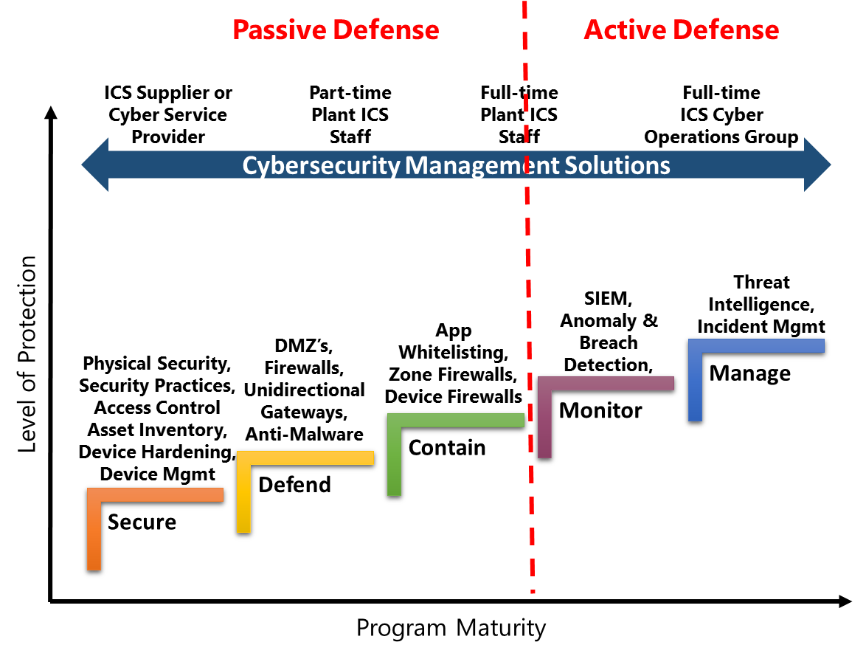

Slide 18


Device hardening – technical controls
This means implementing and configuring security features to provide enhanced protections.
Anti virus
Exploit protection
Application Control Policies
Host-based firewall
Internet content filtering
What are we trying to accomplish?

Slide 19
Data classification and protection
There is a reason why the CIS basics begins with hardware and software inventory. The basis for assurance resides in identifying two things:
Subjects – People and process
Objects – Systems and data repos
Inventory means not only cataloging the assets, but apply labels to them based on process, owners, and the classification of data they hold.

Slide 20
Data classification and protection
Access is known as entitlement. There should be a formal process to request these – a paper trail.
Entitlements require regular auditing known as user recertification.
When this occurs, it’s important match label to clearance.
Objects have labels and subjects have clearances.
Compartmentalization is a technical method for enforcing need to know.

Slide 21
Biba for Integrity
Biba is a setup where a user with lower clearance can read higher-level information (called “read up”) and a user with high-level clearance can write for lower levels of clearance (called “write down”).
The Biba model is typically utilized in businesses where employees at lower levels can read higher-level information and executives can write to inform the lower-level employees.

Slide 22
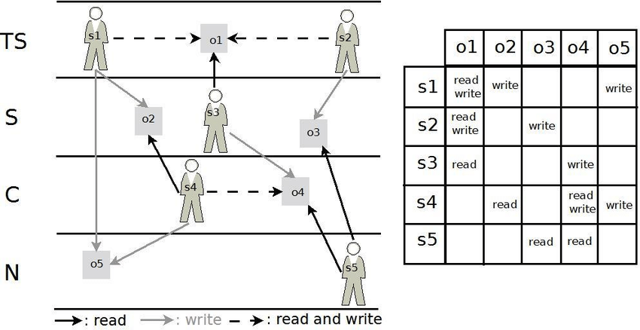
BiBA – Read up, write down

Slide 23
Bell-Lapadulla for Confidentiality
The opposite: read down, write up. This security model is known as Bell-Lapadulla:
“Top Secret” shall be applied to information, of which the unauthorized disclosure could reasonably be expected to cause exceptionally grave damage to national security.
“Secret” shall be applied to information, of which the unauthorized disclosure could reasonably be expected to cause serious damage to national security.
“Confidential” shall be applied to information, of which the unauthorized disclosure could reasonably be expected to cause damage to national security.
Private sector companies use labels such as “Internal Use Only” and “Company Proprietary” to categorize information.

Slide 24
